Slide 1
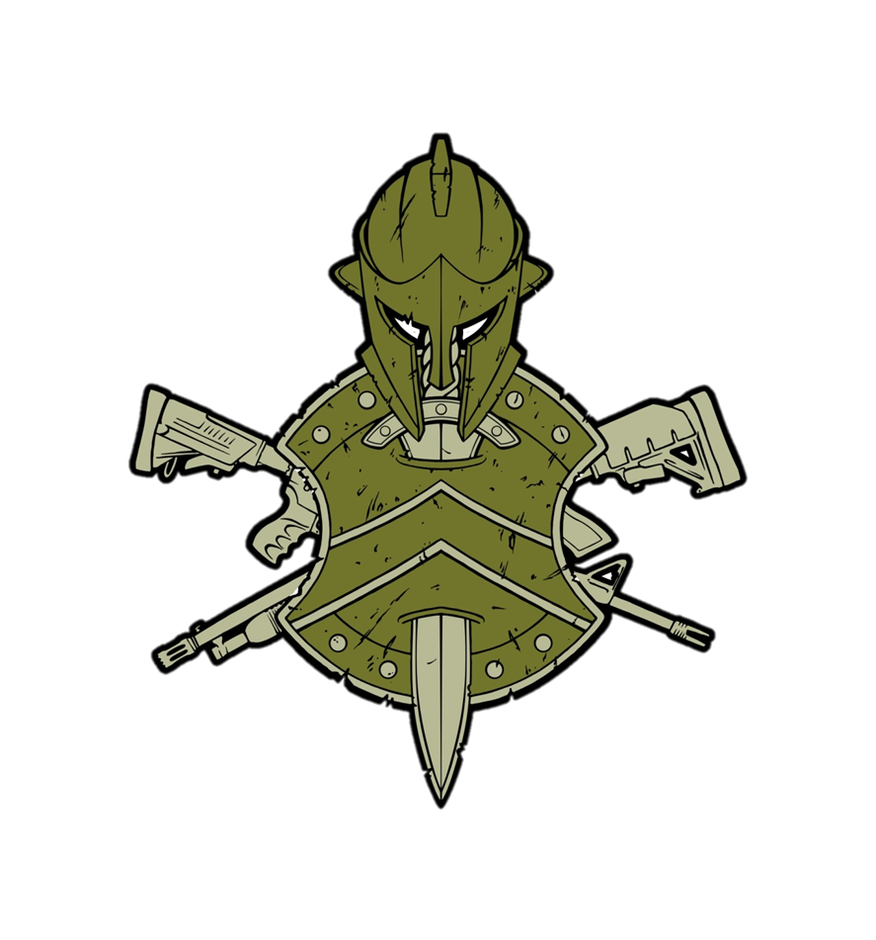
Nemesis group
Watch & protect your children
Created By:
Anthony Patterson

Slide 2
What is Child Trafficking & Kidnapping???
Trafficking of children is the buying and selling of children, under the age of 18, for the purpose of exploitation of some sorts. Children are typically exploited and used for child soldiering, forced labor, and or sex slavery. Children are obtained by means of force (kidnapping or obduction), fraud and false promises, and coercion.
CHILD TRAFFICKING INCREASES EVERY YEAR!!!
Notes:
It is estimated to generate over $39 billion annually.

Slide 3
It Occurs Everywhere!!!
Not just overseas.
Its in all 50 States.
Closer to home than you may think.
It occurs in large and small cities, towns, villages, and territories.
YES, IT OCCURS IN OR VERY NEAR THE AREA THAT YOU LIVE IN!!!
Notes:
Unicef USA at https://www.unicefusa.org/stories/child-trafficking-hits-close-home/36189 is a great child trafficking source for education, awareness, and protection.
It happens to all walks of life. Though it does occur amongst immigrants, the undocumented, low-income, and middle-income; it actually occurs in all walks of life; rich & poor, native & foreign. Race, class, education, gender, age, or citizenship are not relevant factors.

Slide 4
Hampton Roads, VA
The Samaritan House (SH) fights against child trafficking in Hampton Roads and also aids and supports trafficking victims.
Since 2016, SH has been involved in and conducted over 365 investigations. There have been over 273 confirmed victims with over 69 of them being minors.
Virginia is nationally ranked 15 in trafficking cases.
In 2020, Immigration and Customs Enforcement (ICE) conducted over 72 investigations with 14 confirmed victims.
Trafficking has increased by 30% since the start of Covid-19.

Slide 5
Trafficking & Kidnapping Methods
Seeking out Vulnerabilities
Isolation
Emotional Abuse
Economic Abuse
Physical Abuse
Familiar Trafficking – Romeo Pimp, Gorilla Pimp, and Family Pimp.
Breaking & Conditioning
Notes:
I) Predators look for children that are vulnerable. Such vulnerabilities include but are not limited to low self-esteem, parental strife or a conflicting relationship with parent(s) or family, and a conflicting relationship with school. Runaways are particularly vulnerable… VI) Often at times, a victim is introduced into trafficking by means of someone they have a close or familiar relationship with. A Romeo Pimp is charismatic, entices, and takes the time to develop a safe and comfortable and often a romantic relationship with the victim. A Gorilla Pimp uses violence and fear. A Family Pimp is a family member, usually a parent, who sells or rents out their own child… VII) Once introduced into the life of trafficking, traffickers may use phrases such as “You are just a whore now”, “No one will believe you”, “Your family won’t love you anymore”, and or “You are the one committing a crime” in order to maintain control over the victim and to mentally and emotionally break the victim thus making the victim feel that the life of being trafficked is all that he or she has. This eventually makes the victim more compliant to being trafficked.

Slide 6
Real World Incidents
Samantha age 12. https://youtu.be/5hjJyg7nc60
Holly Austin Smith age 14; ran away with man she met at a local mall and was forced into trafficking.

Slide 7
Real World Incidents (continued)
Shari 15 years old & cousin 14 years old; taken and trafficked from a Wendy’s. https://vimeo.com/399290663
Sarah Cooper age 14/15; lured by a predator on social media. https://vimeo.com/563939224
Petra age 16; kidnapped. https://www.youtube.com/watch?v=TE0phtoqB2o

Slide 8
Real World Incidents (continued)
https://www.abc4.com/news/local-news/child-sex-trafficking-victim-shares-her-story-of-survival/

Slide 9
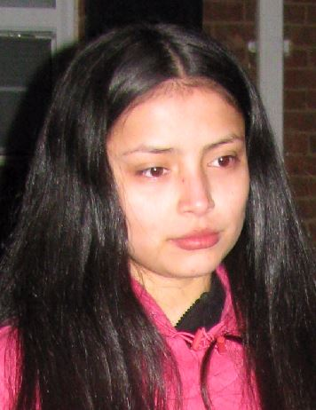
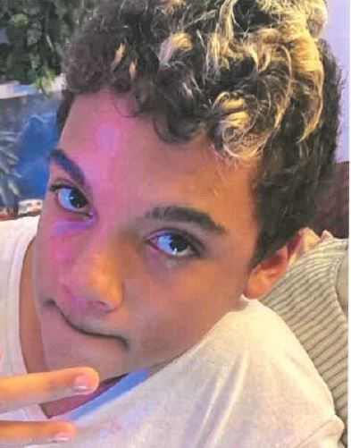
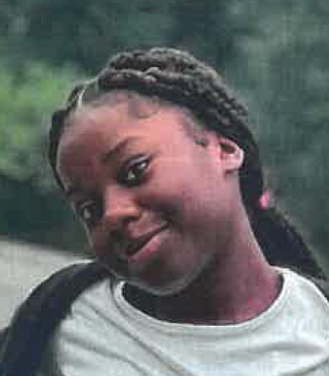
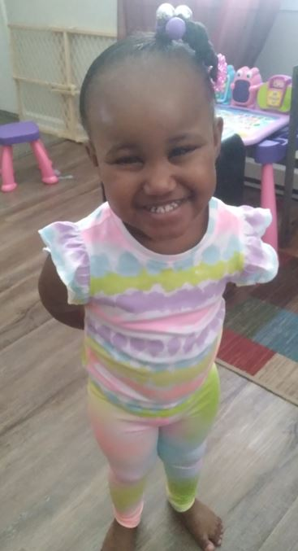
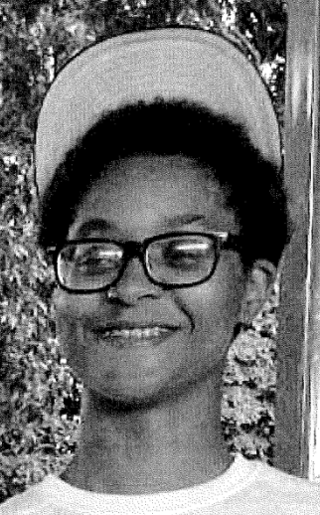
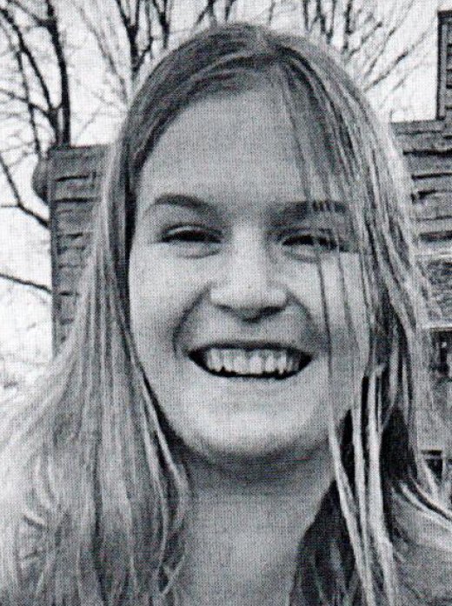
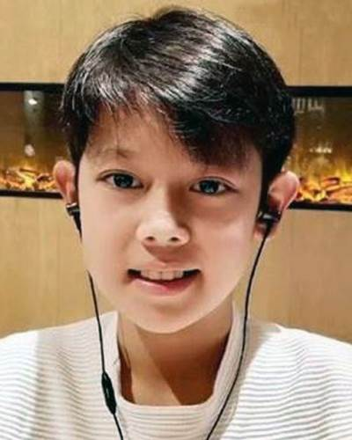
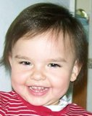
Missing Children in Hampton Roads, VA and Virginia:
Ages 3 - 17
Notes:
National Center for Missing & Exploited Children: https://api.missingkids.org/missingkids/servlet/PubCaseSearchServlet?act=usMapSearch&missState=VA&searchLang=en_US&casedata=latest

Slide 10
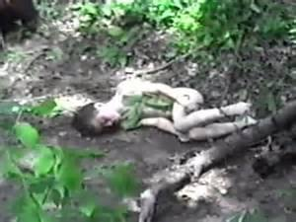
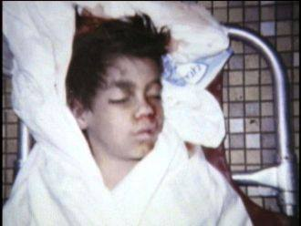
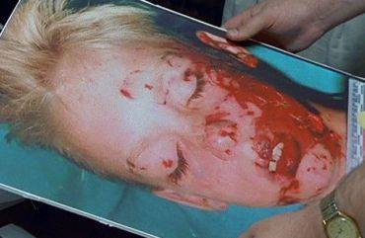
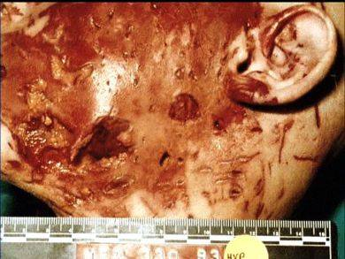
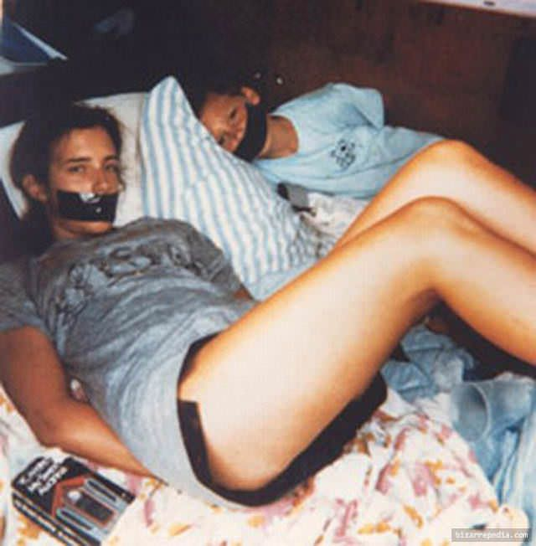
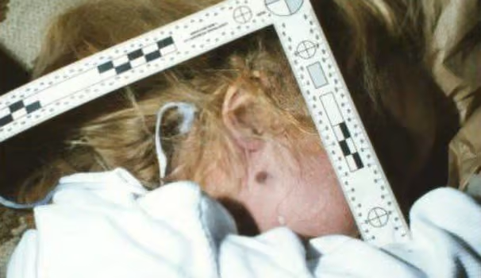
Children Found Dead

Slide 11
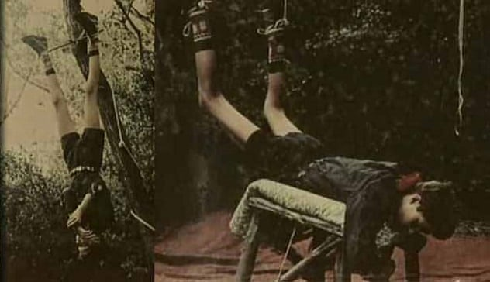
Children Found Dead (continued)

Slide 12
How To Protect Our Children
Be your child(ren) first and most valued resource.
Keep open and honest communication with your child(ren).
Reality and dangers of child predators.
Ensure your child(ren) has other positive influences.
Know your child(ren)’s whereabouts and friends.
Know your child(ren)’s online activity and promote safety and privacy.
Know your neighborhood and let your neighborhood know you and your child(ren).
KNOW YOUR CHILD(REN)!!!
Notes:
Ensure that your children know that they can always seek out help and come home. Your children should know that no predator is more powerful than you are and the love you have for them. Always maintain open communication with your child(ren). They should know that they can always talk to you about any problem and that you will listen. Not only will you listen, but you will believe them. Discuss healthy relationships as well as healthy sexual relationships with your child(ren).
Introduce your child(ren) to and discuss with them the reality and dangers of child predators. Let them know that it can happen to them.
Ensure that your child(ren) have other positive figures in their life. Such influences could be counselors, teachers, and other family members such as grandparents, aunts & uncles, cousins, and God parents.
Know your child(ren)’s whereabouts and know who their friends are. Not only that, but know how to reach and contact their friends and their friends’ parents. If necessary, your children can be tracked via their phones and there are also covert devices like bracelets and necklaces that can be used to track your child(ren).
Know the social media accounts that your child(ren) have and their online interests, activities, and interactions. Teach your children about online safety, what is and is not OK to post online, and security protocols such as not posting identifiable information online such as home addresses and schools. Ensure the right privacy settings are established.
The concepts of “It takes a Village to raise a child” has never been more true. Ensure that the neighborhood knows you and your child(ren). You and the neighborhood should also know what people and vehicles are familiar to your neighborhood. Familiar does not just refer to who actually lives in the neighborhood but who frequently visits the neighborhood too. A neighborhood watch is a great tool and organization to have.
Know your children so that you can quickly recognize when and if something is wrong.

Slide 13
Resources
Samaritan House: (App available)
- 2620 Southern Boulevard, Virginia Beach, Virginia 23452
- Phone: 757-631-0710
- https://samaritanhouseva.org
Human Trafficking Hotline
- 757-430-2120
- (888) 373-7888
- Text ‘HELP’ OR ‘INFO’ to 233733
Virginia State Fusion Center and Department of Homeland Security
- See Something Send Something (app)
- See Something Say Something: Call 877-4VA-TIPS
- https://fusion.vsp.virginia.gov

